Slide 1
Supply
Circulating Fluidized Bed Boiler
Dowon SHUN
Korea Institute of Energy Research
Notes:
산업용 보일러의 운전특성을 요약하였다.

Slide 2
KIER’s Wonju 10MWe Technology Transfer
KEPCO-E&C
KOREA MID POWER
Owner’s Engineer
Employer
Proj. Management
Dowha E
SK E&C
Contractor
Vendor’s Engineer
Financial
Plant design
KIER
Seen Tec
Construction C.
Sub Vendors
Basic Eng
Boiler vendor
Fans, Turbine, Condenser
Patent
Reference

Slide 3
Supply scenario
Project가 추상적
2MWe Electric-Biomass
Project가 구체적
2MWe CFBC-Biomass
Employer
Invitation to Proposal
Invitation to Bid
Proposal
Bid
Notice of award
Notice of award
Commencement
Commencement
KIER
Design, Engineering, Commissioning

Slide 4
Deliverables
Power plant Project
Document
Time control
Plant Document
Plant
Manufacturing
Procurement
Design
Commissioning
Training
Maintenance Manual
Construction
KIER Involved in yellow colored block
Basic Design by KIER

Slide 5
Design Steps
Conceptual Design
Boiler Design Specificatons
Contract
Budget
Basic Engineering Design Data
Mass Balance
Heat Balance
Pressure parts
Basic Design
Non-Pressure parts
Technical Data
Draft system
Detail Design
Shop Drawing
Documents
Calculations
Design Report
Manuals

Slide 6
Supply procedure
사전 자격은 대출기관이 대출자의 정보를 분석하여 대출 자격이 되는지를 잠정적으로 평가하는 프로세스
Invitation to project
PRE QUALIFICATION
Contract – Conceptual Design
BASIC ENGINEERING Design Data
BASIC DESIGN
DETAIL DESIGN
Procurement and Manufacturing
Construction
Commissioning
PROJECT evaluation

Slide 7
1. Invitation to project
Project definition
Base data
Size, scale, fuel condition
Conditions of climate, utility, transport
Location etc.
Laws and Regulations
Invitation to Bidding
Terminal data
Contract condition

Slide 8
2. PRE QUALIFICATION
Business owner’s evaluation of tendering party(contractor)
Financial ability
Company structure, men power
Business performance record in identical and similar area – References of Technology
Qualifications and performance record
Summarize the Short list of tenders

Slide 9
Feasibility Study
Upon Business owner’s request the bidder should supply
Technical
Land, Water, Transportation
Design Specifications
Process Descriptions
Fuel conditions
Financial
Budget, Investment, stock
Total investment
Profit and Investment Return

Slide 10
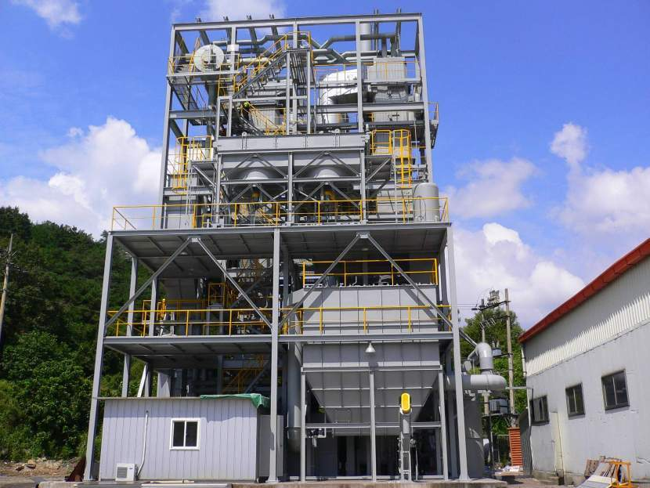
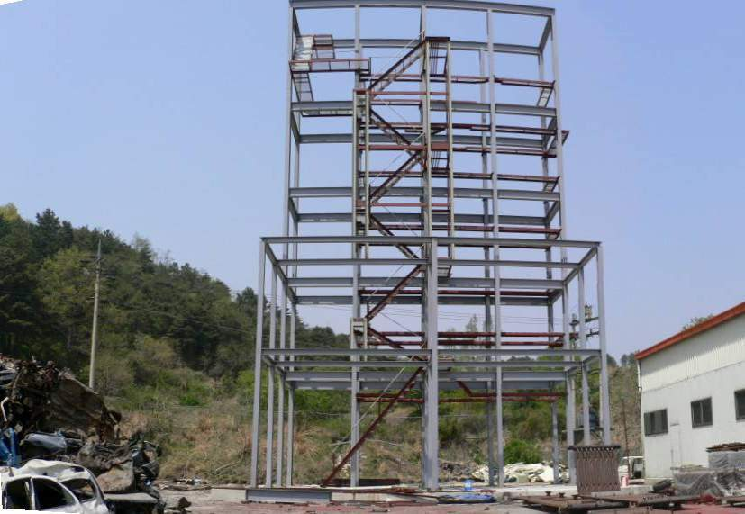
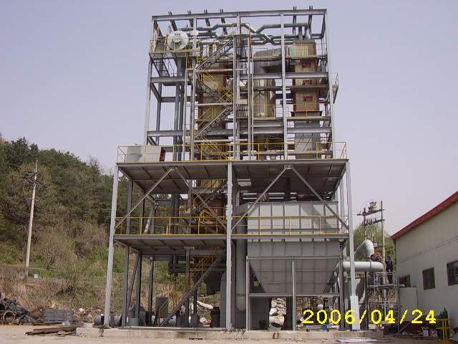
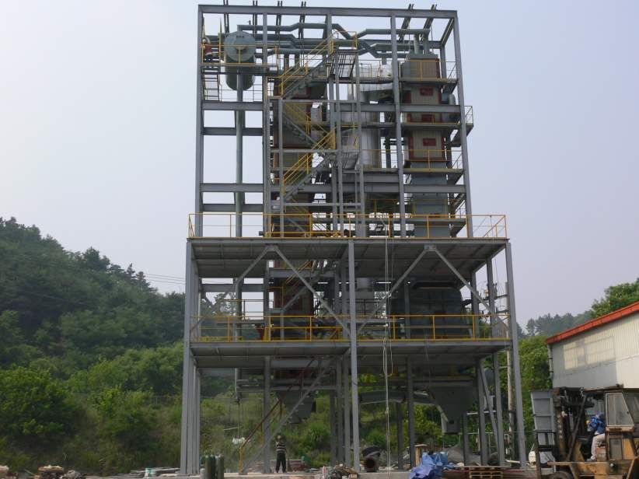
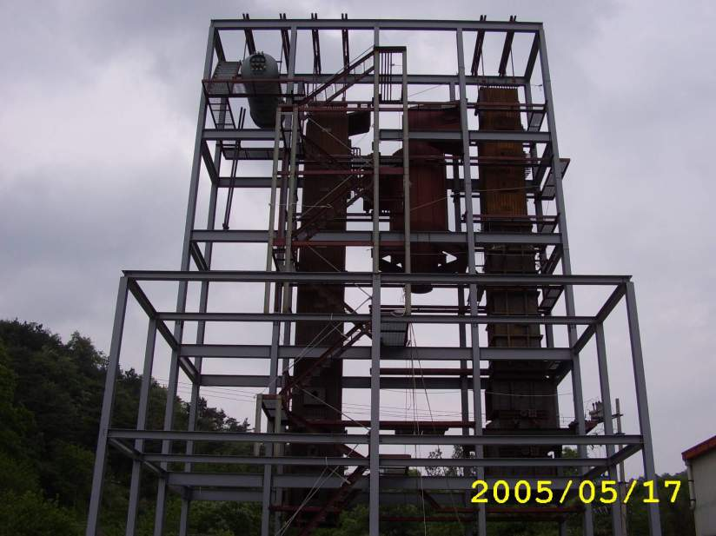
CFBC Demonstration plant constructon
Conceptual

Slide 11
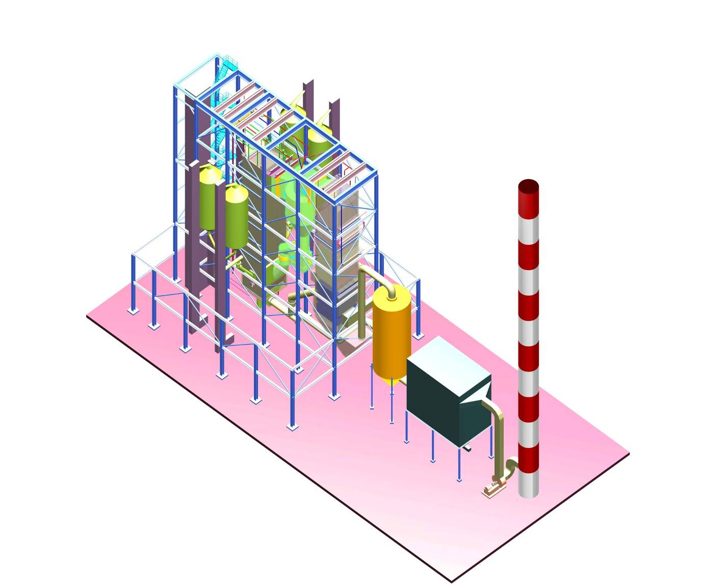
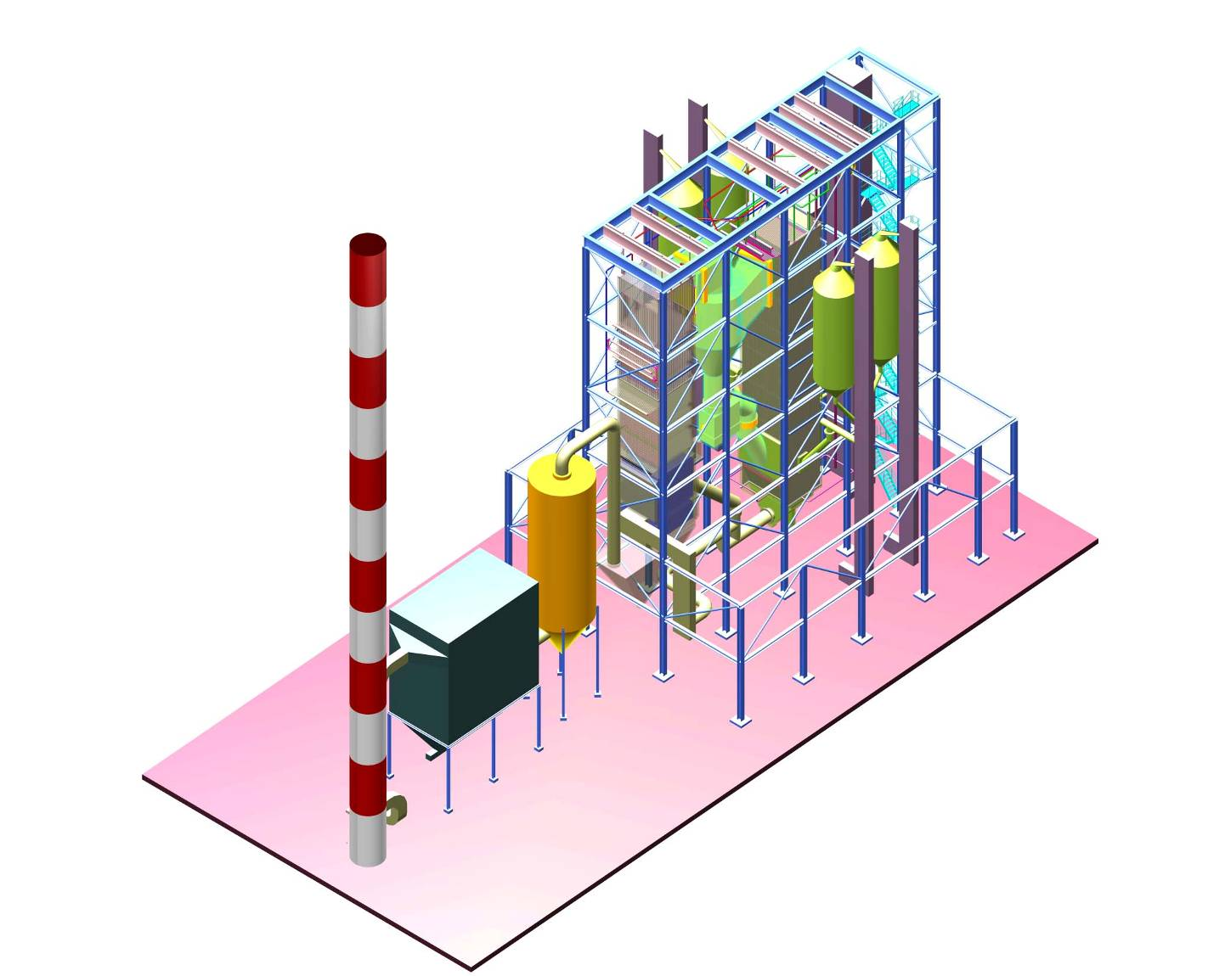
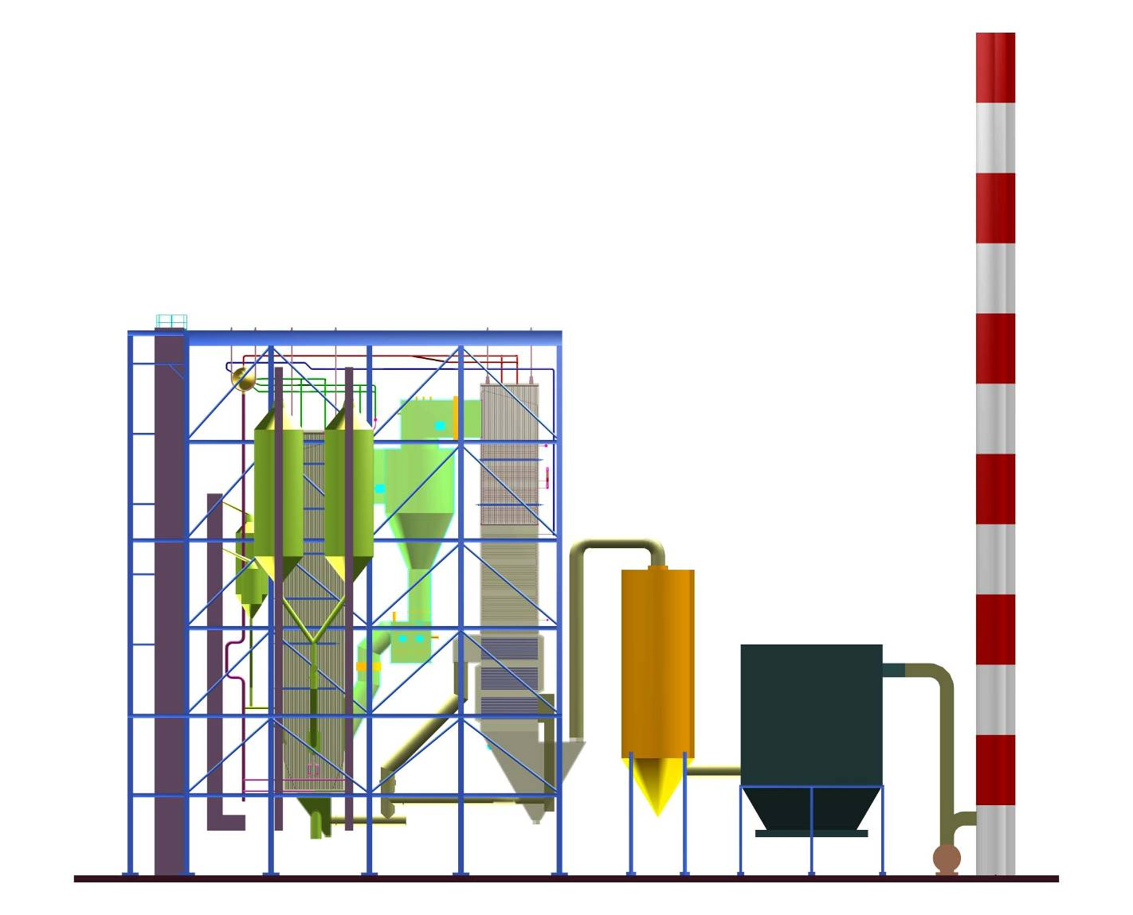
보일러 구성(원주 10MWe 발전용 보일러)
Conceptual

Slide 12
Example of Design specifications
Conceptual
Item | Unit | Value
Number of unit | - | 1
Type | - | One drum natural circulating fluidized bed coal combustion boiler with Dual cyclone and Single convection pass
Location | - | In door
Steam quality | - | Max/(Nominal)
Evaporation | ton/h | 105/(96)
Pressure at final super heater exit | bara | 67/(65)
Steam temperature | ℃ | 487/(487)
Power generation | MWe | 22
Average solid contents in final steam | ppm | 1.0
Average solid contents in drum | ppm | 750
Feed water at Ash cooler inlet | ℃ | 196/(192)
Steam temperature control range | ℃ | 477-487
Draft system |  | Balanced draft
Turn down ratio |  | 2 : 1
Ambient temperature | ℃ | 20
Reference relative humidity | % | 60

Slide 13
Emission targets
Conceptual
Parameter | Unit | Value
Sox | mg/Nm3 | 200
Nox | mg/Nm3 | 200
CO | mg/Nm3 | 200
Particulates | mg/Nm3 | 20
HCl
dioxine

Slide 14
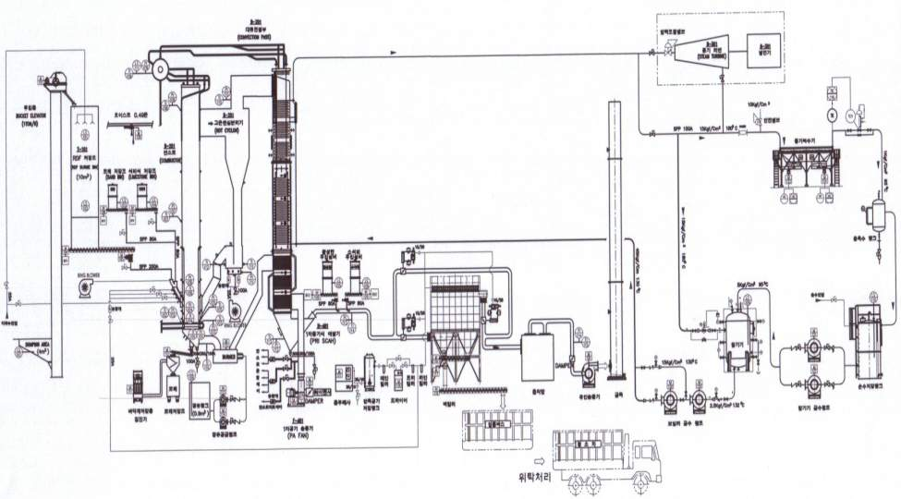
Terminal points
Conceptual

Slide 15
Lay out of Combustor and Back pass
Conceptual
Superheater
Combustor
Cyclones
Economizer
Air heater
B1
A1
B2
A2

Slide 16
Supplier document for contract
A. general | Technical Bid Evaluations
 | Sub-vender list
 | Equipment Catalogue and Experience List
 | ASSUMPTIONS, COMMENTS AND CLARIFICATIONS
 | DEVIATION AND CLARIFICATION LIST (IF REQUIRED)
 | SCOPE CHART
 | TERMINAL POINTS
 | DESIGN BASIS
 | Equipment Manufacturing and Fabrication Schedule
 | Capital Spare Part List (by SPIR form)
 | Construction & Commissioning Spare Part List (by SPIR form)
 | Two Years operation Spare Part List (by SPIR form)
 | Special Tools List for Erection, Maintenance and Operation, if any
 | Utility Consumption List
 | REQUIREMENTS (WATER AND OTHER)
 | PERFORMANCE GUARANTEE
 | PRICE SCHEDULE
 | COMMERCIAL TERMS AND CONDITIONS
B. mechanical | General arrangement Drawing
 | Dimensional DWG and Weight for Delivery to site
C. Process | Data Sheet for overall PKG. and each Equipment
D. Structure and civil | loading data & anchor plan (Dynamic & Static Load) with center of gravity
E. piping | Plot Plan
F. Electrical & Instrument Schematics | Motor list
 | (local) control panel layout drawing
 | Electrical Load Data
G. Inspection & Test | Inspection & Test Plan Including Burner

Slide 17
3. Contract
Ordering Party’s request
Scope of business
Design basis and concept
LIMITATIONS
BOND
Cost data or estimation
Submit Quotation
Contract

Slide 18
Quotation
Quotation & Quotation number 17
Your company name, address & VAT nr.
Date: Sep 21, 2022 & valid through Jan 01, 2023
Payment condition:
10% payment required to start work
Final payment within 30 days on the approval of the final commissioning report
Customer name, address & VAT nr.
Description of the contract
Additional description
Signature

Slide 19
COST ESTIMATION
TERMINOLOGY
ORDER OF MAGNITUDE ESTIMATION(RATIO ESTIMATE)
STUDY ESTIMATION(FACTORED ESTIMATE)
PRELIMINARY ESTIMATE(BUDGET ESTIMATE, CONCEPTUAL ESTIMATE)
DEFINITIVE ESTIMATE(PROJECT CONTROL ESTIMATE)
DETAILED ESTIMATE(FIRM ESTIMATE)

Slide 20
BOND
TERMINOLOGY
BIDDING GUARANTE BOND: 2-10% of Bid Price
PERFORMANCE BOND: Duty guarantee of Contractor to Ordering Body,10-20% of contracted price
ADVANCE PAYMENT BOND/ REFUNDMENT BOND
MAINTENANCE BOND: 10-20% of contracted price
RETENTION BOND/RETENTION MONEY BOND: RETENTION MONEY for Secure of duty fulfillment, 5-10% of contracted price

Slide 21
4. BASIC ENGINEERING DESIGN DATA(1)
BASIC ENGINEERING DESIGN DATA (BEDD) CALCULATION
PROCESS DESCRIPTION
PROCESS FLOW DIAGRAM(PFD) W/ HEAT&MATERIAL BALANCE
PIPING & INSTRUMENT DIAGRAM(P&ID);FOR APPROVAL
UTILITY FLOW DIAGRAM(UFD)

Slide 22
4. BASIC ENGINEERING DESIGN DATA(2)
EQUIPMENT DATA SHEET
PLOT PLAN
DUTY SPECIFICATION
EQUIPMENT LIST
INSTRUMENT PROCESS DATA SHEET
LOGIC DESCRIPTION
SINGLE LINE DIAGRAM
SAFETY REVIEW ; PRELIMINARY

Slide 23
4. BASIC ENGINEERING DATA(3)
HAZARDOUS AREA CLASSIFICATION DRAWING
CATALYST & CHEMICALS SUMMARY
EFFLUENT SUMMARY
OPERATION INSTRUMENT

Slide 24
4. BASIC ENGINEERING DESIGN DATA (4)
TERMINOLOGY
LOCATION OF PLANT SITE
CODE AND STANDARDS
GEOLOGICAL CONDITION: SITE ELEVATION/EARTHQUAKE
CLIMATIC CONDITION: AIR TEMPERATURE/HUMIDITY/RAIN FALL/SNOWFALL/WIND/ BAROMETRIC PRESSURE ETC.
PROCESS DESIGN BASIS : FEED/PRODUCT SPECIFICATION/CHEMICAL AND CATALYST/BATTERY LIMIT CONDITIONS/SYSTEM OF MEASUREMENTS/EQUIPMENT DESIGN REQUIREMENT/INSTRUMENT DESIGN REQUIREMENT/OTHER SPECIAL REQUIREMENT
UTILITY CONDITIONS: WATER/STEAM AND CONDENSATE/ELECTRIC POWER/FUEL GAS AND OIL CONDITION/INERT GAS AND AIR CONDITION
POLLUTANT AND ALLOWABLE LIMITS :WASTE EFFLUENT CONDITION/NOISE LIMITATION

Slide 25
Process Description
TERMINOLOGY
Main PROCESS description, Use of main parts, DATA SHEET and Process conceptual
Owner review and approval
Provide information of PROCESS PLANT to DETAIL ENGINEERING

Slide 26
Process Flow Diagram(PFD)
TERMINOLOGY
PROCESS의 FLOW SCHEME, HEAT & MATERIAL BALANCE, OPERATING CONDITION
Owner REVIEW, COMMENT and APPROVAL
Flow of EQUIPMENT & PROCESS Basic instrumentation and control SCHEME
Operating variables
STREAM NUMBER

Slide 27
EQUIPMENT DATA SHEET
TERMINOLOGY
PUMP DATA SHEET
COMPRESSOR & BLOWER DATA SHEET
VESSEL & TANK DATA SHEET
SHELL AND TUBE HEAT EXCHANGER DATA SHEET
AIR COOLER DATA SHEET
COLUMN DATA SHEET
FRACTIONATION TRAY LOADING DATA SHEET
FIRED HEATER DATA SHEET

Slide 28
PLOT PLAN
TERMINOLOGY
Planning and layout of Mechanical parts, Piping, Electricity of PLANT
PLOT PLAN consideration; Economy, Environment, Topography, future plan, Roads, Manufacturer, Efficiency, Safety, Easy maintenance, Compatibility with existing plant.
PIPING ENGINEER Drawing, PROCESS ENGINEER가 COMMENT

Slide 29
DUTY SPECIFICATION
TERMINOLOGY
Purpose, Function,DUTY, CAPACITY, Design and Operation Condition, GUARANTEE- WATER TREATMENT SYSTEM
STEAM GENERATION SYSTEM
COOLING WATER SYSTEM
AIR COMPRESSION SYSTEM
INERT GAS GENERATION SYSTEM
REFRIGERATION SYSTEM
FLARE SYSTEM

Slide 30
EQUIPMENT LIST
TERMINOLOGY
All the EQUIPMENT in PROCESS
Specification of each Unit is available in PLANT PROPOSAL for COST ESTIMATION
Detailed INFORMATION must be provided for Detailed Design and other JOB performance

Slide 31
5. BASIC DESIGN(1)
PIPING and INSTRUMENT DIAGRAM(P&ID); AFD
UTILITY P & ID
SHORT SPEC. EQUIPMENT LIST
FINALIZED EQUIPMENT DATA SHEET
UPDATED PIPING MATERIAL SPEC.
FINALIZED PLOT PLAN
PIPE LINE TABLE

Slide 32
5. BASIC DESIGN(2)
FINALIZED INSTRUMENT PROCESS DATA
LOGIC DIAGRAM
UPDATED SINGLE LINE DIAGRAM
UPDATED HAZARDOUS AREA CLASSIFICATION
HYDRAULIC CALCULATION FOR PUMP, REBOILER ETC.
HAZOP STUDY
FINALIZED CHEMICALS BASED ON RELEVANT VENDOR INFORMATION

Slide 33
6. DETAIL DESIGN
PIPING & INSTRUMENT DIAGRAM(P&ID); AFC
Construction diagram Specifications
Drawing and Duty Specifications for procurement
Quantity estimation for procurement
Calculation Sheets
Quantity estimation for construction
Operation manual

Slide 34
PIPING & INSTRUMENT DIAGRAM(P&ID)
TERMINOLOGY
LEGEND & SYMBOL
Specifications of All PROCESS Mechanical Parts including STAND-BY Parts
PIPE, DUTY, SIZE and MATERIAL SPECIFICATION
All VALVE and DAMPER
All EQUIPMENT/INSTRUMENT/LINE NUMBER
FLOW DIRECTION
Piping Material, INSULATION, HEAT TRACING
Design specification of piping and instrumentation

Slide 35
PROCESS INFORMATION FOR PIPING AND INSTRUMENT
TERMINOLOGY
INSTRUMENT PROCESS DATA SHEET
CONTROL VALVE DATA SHEET
FLOW/LIQUID/LEVEL/TEMPERATURE/PRESSURE/INSTRUMENTATION
PROCESS ANALYZER SPECIFICATION
ALARMS AND PROTECTIVE SYSTEM
PRESSURE RELIEF DEVICE DATA SHEET
PIPELINE DESIGNATION TABLE
INSULATION and HEAT TRACING
PWHT
Operation and Design conditions

Slide 36
SAFETY ANALYSIS
TERMINOLOGY
HAZOP STUDY(HAZARD AND OPERABILITY STUDY)
Fire and Explosion Simulation

Slide 37
7. Procurement and Manufacturing
PURCHASING
EXPEDITING
INSPECTION
TRANSPORTATION

Slide 38
Procurement procedure
Market research
Analysis of VENDOR data
Supply procedure
REQUEST FOR QUOTATION
INQUIRY DOCUMENTS
Evaluation of Quotation and Documents
NEGOTIATION
Order/Contract
Payment of Price

Slide 39
8. construction
Construction management
Materials management

Slide 40
Construction Management
Organization of field management team
Construction and Manpower planning
Process planning and management
Working budget management
Building work
Equipment utilization and management
Construction method
Quality control
Labor control
Sub-vendor control
Health and Safety control
Communication with ordering organization

Slide 41
Materials management
Material planning
Necessary quantity & receiving schedule
Custom and inland transportation
Ware house/yard storage and their security
Inspection
Material transaction book
Inventory control
Insurance claim for damage/theft during transaction and storage
Prediction of material and spares
List up of excess material and its disposal

Slide 42
9. Commissioning
PRECOMM`G & COMM`G PLAN
TRAINING PROGRAM
PRE COMMISSIONING ACTIVITIES
COMMISSIONING ACTIVITIES
SYSTEM Check up
UTILITY & OFF-SITE AND AUXILIARY SYSTEM Test and Operation
MOCK OPERATION
INITIAL START-UP
PERFORMANCE GUARANTEE TEST

Slide 43
OFF-THE-JOB TRAINING
Operation, Maintenance, Environmental, Safe Staffs
PROCUREMENT/ CONSTRUCTION Stage
LICENSOR TRAINING COURSE
VENDOR TRAINING COURSE

Slide 44
ON-THE-JOB TRAINING
OPERATOR, MAINTENANCE Staffs
PRE/COMMISSIONING Stage

Slide 45
Pre commissioning
THE PLANT HAS BEEN MECHANICALLY AND STRUCTURALLY COMPLETED
ALL SYSTEMS HAVE BEEN PUT IN A TIGHT AND CLEAN CONDITION
HYDRO TESTED
PUNCH LIST WORK COMPLETED
ENGINEERING DOCUMENT AND VENDOR INFORMATION COMPLETED

Slide 46
Items for precommissioning
PIPING SYSTEM
ROTATING EQUIPMENTS
STATIONARY EQUIPMENTS
PACKAGE UNITS
INSTRUMENTATION
ELECTRICAL PARTS
SYSTEM

Slide 47
Commissioning procedure
CLEANING PROCEDURE
WATER CIRCULATION PROCEDURE
AIR BLOWING PROCEDURE
TIGHTNESS TEST PROCEDURE
PURGE PROCEDURE
CHEMICAL CLEANING PROCEDURE
PIPING SYSTEM FIELD TEST PROCEDURE
PREPARATION PROCEDURE FOR SPECIAL ROTATING MACHINE

Slide 48
Commissioning activities
SYSTEM check up
UTILITY & OFF-SITE AND AUXILIARY SYSTEM test
MOCK OPERATION
INITIAL START-UP
PERFORMANCE GUARANTEE TEST

Slide 49
PERFORMANCE GUARANTEE TEST
TERMINOLOGY
Consumption of Feed Stock or Fuel
Production rate of PRODUCT (STEAM, Power…)
UTILITY Consumption
PERFORMANCE TEST SHEET

Slide 50
10. PROJECT evaluation
Analysis of Data and Information during the PROJECT. Collection of Design parameter for the next ROJECT.
TECHNOLOGY,
COST,
SCHEDULE,
QUALITY,기타
Data file/Evaluation Report/ROJECT CLOSE OUT REPORT

Slide 51
Many Thanks.

